Slide 1
Responsive Design
WEBD 152 - Web Programming 2
Link to slides: http://bit.ly/humber-web-2-12
Ryan Christiani
Week 12

Slide 2
Tools
There are a lot of tools out there that can help you build a better faster workflow. Lets look at a few.
Terminal
NPM
Grunt/Gulp
Markdown
Git/Github

Slide 3
Terminal
The terminal is a powerful tool, a lot of development tools are moving towards the command line. Lets look at a few commands that can help you get going.
On a mac there is the a program called terminal that we use to get access to the command line. I suggest using iTerm2 it is a great replacement from the standard program.
If you are on windows I suggest getting cmder this is a great replacement for the default windows prompt, and it lets you do a lot of the unix style commands we can do on mac.

Slide 4
Terminal common commands
cd - change directory ex: cd Desktops/folder/newfolder
ls - list directory
pwd - present working directory
man - When used like man cd, this program will give you a manual for the cd program, this is great if you want to find out how something works.
cat - will show you the contents of a file.

Slide 5
Terminal common commands cont.
Editors on the command line.
nano - a simple editor that you can use to edit files from the command line.
vim - another editor, much harder to use though.

Slide 6

NPM
Not another packer manager, nice people matter, node package manager.
NPM is a system built on top of Nodejs that always use to use little packages in our NodeJS projects, or now, in our regular client side projects.
Resources:
NPM Site
Getting started, to get started you need Node, once you install node NPM will be installed as well. So there is little you need to get started.

Slide 7

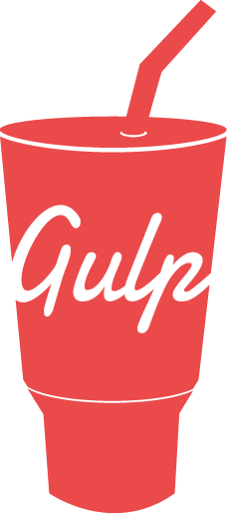
Grunt & Gulp
Grunt and Gulp are Javascript build tools. They allow us to do things like compile sass, or lint our javascript, concatenate files together, and so much more.
Grunt
Gulp
Lets walk through a gulp example using sass.

Slide 8
Markdown
Markdown is a simple language that lets you write simple content. Mostly used to write blog posts or simple content pages. The syntax is really simple
Syntax documentation
When you write with markdown you will need something to compile it to be HTML. Remember we can write markdown in Jekyll, you can also use markdown to write content for github.
A great sublime text plugin is Markdown preview.

Slide 9
Git and GitHub
Git is a system built for version control. Think dropbox.
When you have a file in dropbox, it is on your computer, but also on a computer somewhere else.
In git we have the concept of a repository, or repo. A repo is where files are stored, we can have local and remote repos.
Locally we use repos to store our files, and remote repos are used to store them so others, or us, can use them later.

Slide 10
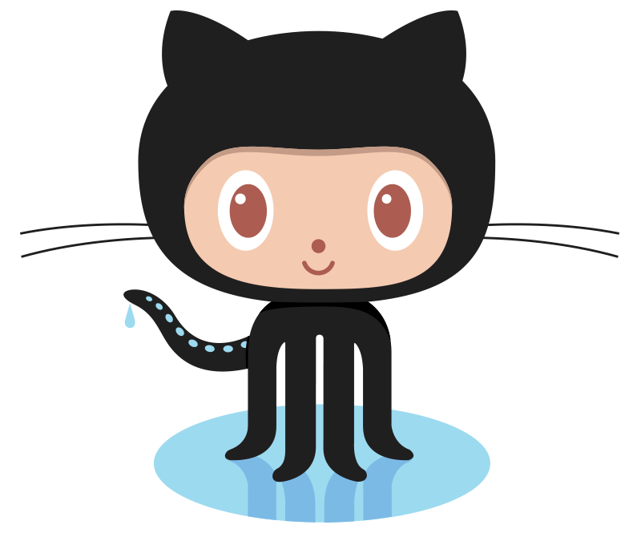
Git and GitHub cont.
The idea of git is to make a bunch of changes from your computer, commit them and then push them to the remote repo.
Lets look at an example I have.
Github is where we store our remote repos, it is a place to share your repos or host private repos you want to only share with certain people.
Here is a great resource for getting started with GIT.

